Slide 1
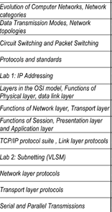
Unit-1

Slide 2

18CSS202J- COMPUTER COMMUNICATION

Slide 3
UNIT –I Contents
Evolution of Computer Networks
Network Categories
Data Transmission Modes
Network Topologies
Circuit Switching and Packet Switching
Protocols and Standards
OSI Layers and its functions
TCP/IP Protocol Suite
Link Layer Protocols
Network Layer Protocols
Transport Layer Protocols
Serial and Parallel Transmissions
Addressing

Slide 4
Session 1
Evolution of Computer Networks
Network Categories
Data Transmission Modes
Network Topologies

Slide 5
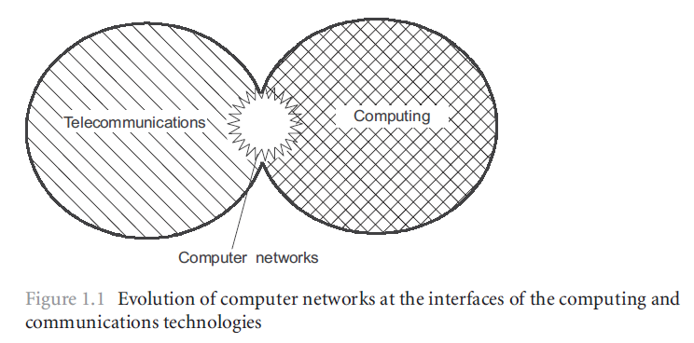
Evolution of Computer Networks
Computer Networks?
A group of interconnected computers
The evolution of two important scientific and technical branches of modern civilization
Computing and
Telecommunications technologies

Slide 6
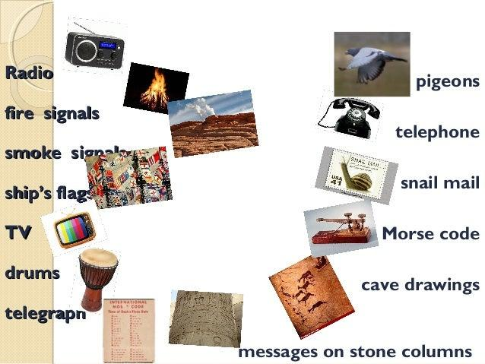
Evolution of Communication

Slide 7
Evolution of Computer Networks
Communication Network?
A network of links and nodes arranged messages may be passed from one part of the network to another
What are nodes and links?
People and roads
Telephones and switches
Computers and routers
What is a message?
Information

Slide 8
Evolution of Computer Networks
Networks are Old
2400 BC: courier networks in Egypt
550 BC: postal service invented in Persia
Problems
Speed
Reliability
Security
1837: Telegraph invented by Samuel Morse
Distance: 10 miles
Speed: 10 words per minute
In use until 1985!

Slide 9
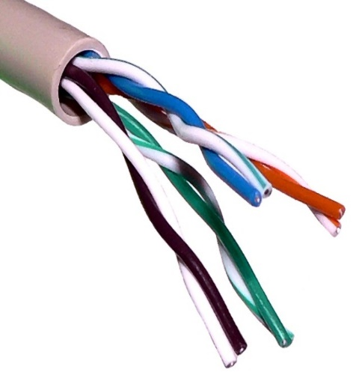

Evolution of Computer Networks
1881: Twisted pair for local loops
1885: AT&T formed
1892: Automatic telephone switches
1903: 3 million telephones in the US
1915: First transcontinental cable
1927: First transatlantic cable
1937: first round-the-world call
1946: National numbering plan
Telephone network is the dominating
communication network
Used circuit switching

Slide 10
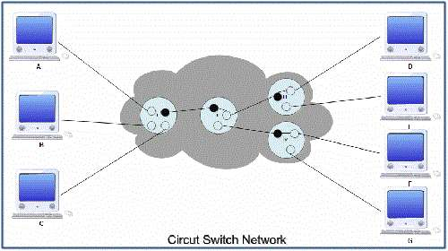
Evolution of Computer Networks

Slide 11
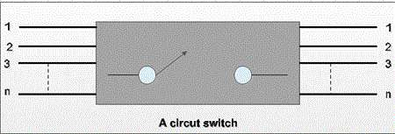
Evolution of Computer Networks
Circuit switching
Telephone networks are circuit switched
Each call reserves resources end-to-end
Provides excellent quality of service
Problems
Resource intense (what if the circuit is idle?)
Complex network components
(per circuit state, security)

Slide 12
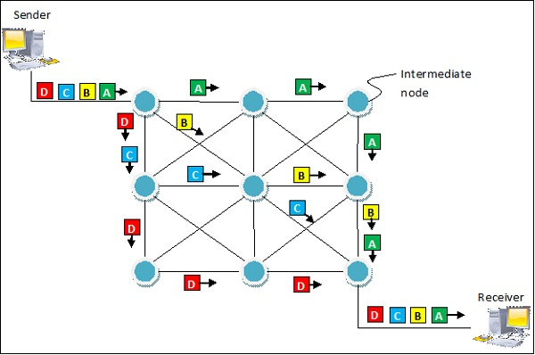
Evolution of Computer Networks
Packet Switching

Slide 13
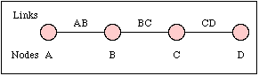
Evolution of Computer Networks
Packet switching
No connection state, network is store-and-forward
Minimal network assumptions
Statistical multiplexing gives high overall utilization
Problems
Resource intense (what if the circuit is idle?)
Complex network components
(per circuit state, security)

Slide 14
Evolution of Computer Networks
From the ARPANET to the Internet
The Advanced Research Projects Agency Network (ARPANET)
It is one of the world's first packet switching
networks
The first network to implement TCP/IP, and was the main progenitor of what was to become the global Internet. (later DARPA)

Slide 15
Evolution of Computer Networks
Internet
The Internet is a global system of interconnected computer networks that use the standard Internet protocol suite (TCP/IP) to link several billion devices worldwide
The packet switching of the ARPANET, together with TCP/IP, would form the backbone of how the Internet works
1972:
ARPAnet is nowconsistent of 15 nodes
The first host-to-host protocol
NCP (Network Control Protocol) enablesapplications to be written
First e-mail program

Slide 16
Evolution of Computer Networks
ALOHAnet
Enabling communication over microwaves between the Hawaiian Islands.
NSFNET
Connection to supercomputing centers
56kbps backbone, later 1,5Mbps and serving as the linkingbackbonebetween regional networks
CSNET
Linking researchers without access to the ARPAnet
BITNET
University e-mail and file sharing
TCP/IP replacing NCP as the standard hostprotocol for ARPAnet

Slide 17
Evolution of Computer Networks
Brief History of the Internet
1961: Kleinrock @ MIT: packet-switched network
1962: Licklider’s vision of Galactic Network
1965: Roberts connects computers over phone line
1967: Roberts publishes vision of ARPANET
1969: BBN installs first
InterfaceMsgProcessor at UCLA
1970: Network Control Program (NCP)
1972: Public demonstration of ARPANET
1972: Kahn @ DARPA advocates
Open Architecture
1972: Vint Cerf @ Stanford writes TCP

Slide 18
Evolution of Computer Networks
1958: First use of a modem
Machine to machine communication
Analog vs. digital signals
Many different computer networks
Local vs. global
LAN, WAN
Public Vs Private
Internet2, SRMNet
General purpose vs. special purpose
E.g. credit cards, banks, defense

Slide 19
Evolution of Computer Networks
Early 1990s: WWW
Hypertext
HTTP: Tim Berners-Lee develops WWW an Internet based hypermedia initiative, and specifies URLs, HTTP and HTML which became basis for today’s WWW
1994: Mosaic (Univ. of Illinois), later Netscape the major browsers until late 1990’s
Commercialization of the WWW, with introduction of HTTPS e-commerce is realized
Late 1990’s:
50 million computers on Internet
100 million+ users
backbone links running at 1 Gbps

Slide 20
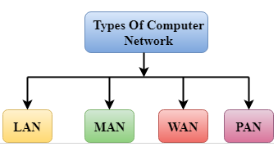
Network Categories

Slide 21
Characteristics of LAN
LAN – Local Area Network
MAN – Metropolitan Area Network
WAN – Wide Area Network
PAN – Personal Area Network

Slide 22
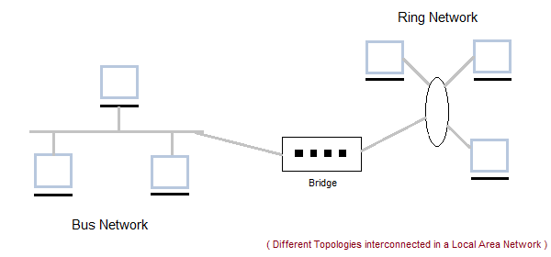
Network Categories
Local Area Network (LAN)

Slide 23
LAN
Local Area Network (LAN) is a group of computers connected to each other in a small area such as building, office.
LAN is used for connecting two or more personal computers through a communication medium such as twisted pair, coaxial cable, etc.
It is less costly as it is built with inexpensive hardware such as hubs, network adapters, and Ethernet cables.
The data is transferred at an extremely faster rate in Local Area Network.
Local Area Network provides higher security.

Slide 24
Characteristics of LAN
LAN's are private networks, not subject to tariffs or other regulatory controls.
LAN's operate at relatively high speed when compared to the typical WAN.
There are different types of Media Access Control methods in a LAN, the prominent ones are Ethernet, Token ring.
It connects computers in a single building, block or campus, i.e. they work in a restricted geographical area.

Slide 25
Applications of LAN
One of the computer in a network can become a server serving all the remaining computers called clients.
Software can be stored on the server and it can be used by the remaining clients.
Connecting Locally all the workstations in a building to let them communicate with each other locally without any internet access.
Sharing common resources like printers etc are some common applications of LAN.

Slide 26
Advantages of LAN
Resource Sharing: Computer resources like printers, modems, DVD-ROM drives and hard disks can be shared with the help of local area networks. This reduces cost and hardware purchases.
Software Applications Sharing: It is cheaper to use same software over network instead of purchasing separate licensed software for each client a network.
Easy and Cheap Communication: Data and messages can easily be transferred over networked computers.

Slide 27
Advantages of LAN
Centralized Data: The data of all network users can be saved on hard disk of the server computer. This will help users to use any workstation in a network to access their data. Because data is not stored on workstations locally.
Data Security: Since, data is stored on server computer centrally, it will be easy to manage data at only one place and the data will be more secure too.
Internet Sharing: Local Area Network provides the facility to share a single internet connection among all the LAN users. In Net Cafes, single internet connection sharing system keeps the internet expenses cheaper.

Slide 28
Disadvantages of LAN
High Setup Cost: Although the LAN will save cost over time due to shared computer resources, but the initial setup costs of installing Local Area Networks is high.
Privacy Violations: The LAN administrator has the rights to check personal data files of each and every LAN user. Moreover he can check the internet history and computer use history of the LAN user.

Slide 29
Disadvantages of LAN
Data Security Threat: Unauthorized users can access important data of an organization if centralized data repository is not secured properly by the LAN administrator.
LAN Maintenance Job: Local Area Network requires a LAN Administrator because, there are problems of software installations or hardware failures or cable disturbances in Local Area Network. A LAN Administrator is needed at this full time job.
Covers Limited Area: Local Area Network covers a small area like one office, one building or a group of nearby buildings.

Slide 30
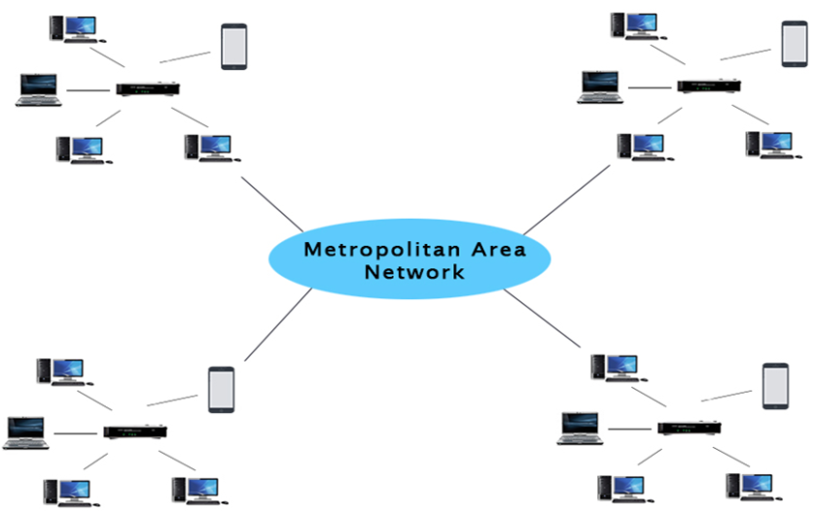
Metropolitan Area Network (MAN)

Slide 31
Metropolitan Area Network (MAN)
A metropolitan area network is a network that covers a larger geographic area by interconnecting a different LAN to form a larger network.
Government agencies use MAN to connect to the citizens and private industries.
In MAN, various LANs are connected to each other through a telephone exchange line.
The most widely used protocols in MAN are RS-232, Frame Relay, ATM, ISDN, OC-3, ADSL, etc.
It has a higher range than Local Area Network(LAN).

Slide 32
Characteristics of MAN
It generally covers towns and cities (50 km)
Communication medium used for MAN are optical fibers, cables etc.
Data rates adequate for distributed computing applications.

Slide 33
Applications of MAN
MAN is used in communication between the banks in a city.
It can be used in an Airline Reservation.
It can be used in a college within a city.
It can also be used for communication in the military.

Slide 34
Advantages of MAN
Extremely efficient and provide fast communication via high-speed carriers, such as fiber optic cables.
It provides a good back bone for large network and provides greater access to WANs.
The dual bus used in MAN helps the transmission of data in both directions simultaneously.
A MAN usually encompasses several blocks of a city or an entire city.

Slide 35
Disadvantages of MAN
More cable required for a MAN connection from one place to another.
It is difficult to make the system secure from hackers and industrial espionage (spying) graphical regions.

Slide 36
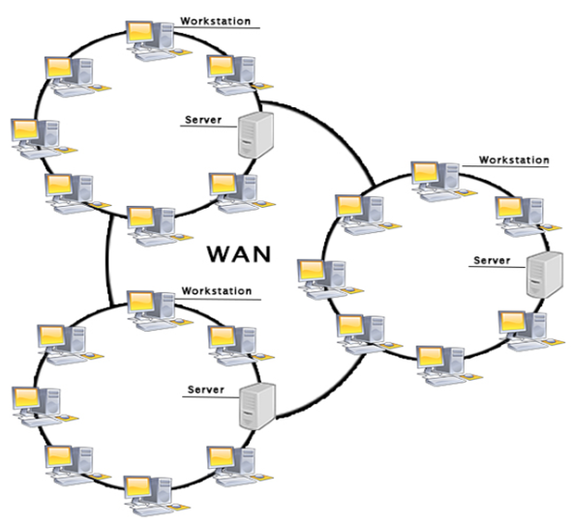
Wide Area Network (WAN)

Slide 37
Wide Area Network (WAN)
It is also called WAN. WAN can be private or it can be public leased network.
It is used for the network that covers large distance such as cover states of a country.
It is not easy to design and maintain.
Communication medium used by WAN are PSTN or Satellite links.
WAN operates on low data rates.

Slide 38
Examples for WAN
Mobile Broadband: A 4G network is widely used across a region or country.
Last mile: A telecom company is used to provide the internet services to the customers in hundreds of cities by connecting their home with fiber.
Private network: A bank provides a private network that connects the 44 offices. This network is made by using the telephone leased line provided by the telecom company.

Slide 39
Characteristics of WAN
It generally covers large distances(states, countries, continents).
Communication medium used are satellite, public telephone networks which are connected by routers.

Slide 40
Advantages of WAN
Geographical area: A Wide Area Network provides a large geographical area. Suppose if the branch of our office is in a different city then we can connect with them through WAN. The internet provides a leased line through which we can connect with another branch.
Centralized data: In case of WAN network, data is centralized. Therefore, we do not need to buy the emails, files or back up servers.
Get updated files: Software companies work on the live server. Therefore, the programmers get the updated files within seconds.

Slide 41
Advantages of WAN
Exchange messages: In a WAN network, messages are transmitted fast. The web application like Facebook, WhatsApp, Skype allows you to communicate with friends.
Sharing of software and resources: In WAN network, we can share the software and other resources like a hard drive, RAM.
Global business: We can do the business over the internet globally.
High bandwidth: If we use the leased lines for our company then this gives the high bandwidth. The high bandwidth increases the data transfer rate which in turn increases the productivity of our company.

Slide 42
Disadvantages of WAN
Security issue: A WAN network has more security issues as compared to LAN and MAN network as all the technologies are combined together that creates the security problem.
Needs Firewall & antivirus software: The data is transferred on the internet which can be changed or hacked by the hackers, so the firewall needs to be used. Some people can inject the virus in our system so antivirus is needed to protect from such a virus.
High Setup cost: An installation cost of the WAN network is high as it involves the purchasing of routers, switches.
Troubleshooting problems: It covers a large area so fixing the problem is difficult.

Slide 43
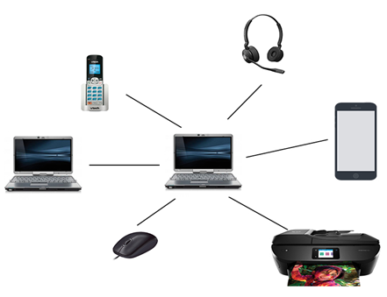
Personal Area Network (PAN)

Slide 44
Personal Area Network (PAN)
Personal Area Network is a network arranged within an individual person, typically within a range of 10 meters.
Personal Area Network is used for connecting the computer devices of personal use is known as Personal Area Network.
Thomas Zimmerman was the first research scientist to bring the idea of the Personal Area Network.
Personal Area Network covers an area of 30 feet.
Personal computer devices that are used to develop the personal area network are the laptop, mobile phones, media player and play stations.

Slide 45
Examples of PAN
Body Area Network: Body Area Network is a network that moves with a person. For example, a mobile network moves with a person. Suppose a person establishes a network connection and then creates a connection with another device to share the information.
Offline Network: An offline network can be created inside the home, so it is also known as a home network. A home network is designed to integrate the devices such as printers, computer, television but they are not connected to the internet.
Small Home Office: It is used to connect a variety of devices to the internet and to a corporate network using a VPN

Slide 46
Data Transmission Modes
The data is transmitted from one device to another device through a transmission mode.
The transmission mode decides the direction of data in which the data needs to travel to reach the receiver system or node.
The transmission mode is divided into three
categories:
1. Simplex 2. Half-Duplex 3. Full-Duplex

Slide 47
Data Transmission Modes
The data is transmitted from one device to another device through a transmission mode.
The transmission mode decides the direction of data in which the data needs to travel to reach the receiver system or node.
The transmission mode is divided into three
categories:
1. Simplex 2. Half-Duplex 3. Full-Duplex

Slide 48
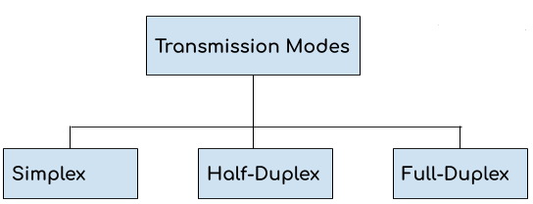
Data Transmission Modes

Slide 49
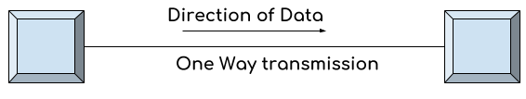
Simplex Mode
1. In simplex mode the data transmits in one direction only, from one system to another system. 2. The sender device that sends data can only send data and cannot receive it. On the other hand the receiver device can only receive the data and cannot send it. 3. Television is an example of simplex mode transmission as the broadcast sends signals to our TV but never receives signals back from our TV. This is a unidirectional transmission.

Slide 50
Simplex Mode
Advantages of Simplex Mode: The full capacity of the transmission medium is utilized as the transmission is one way and cannot have traffic issues.
Disadvantages of Simplex Mode: No bidirectional communication is possible. Two devices cannot communicate with each other using simplex mode of transmission.

Slide 51
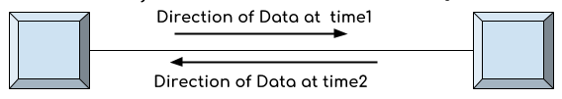
Half-Duplex Mode
1. In half duplex mode transmission can be done both ways which means if two systems are connected with half-duplex mode of transmission, they both can send and receive data but not at the same time. 2. If one device is sending data then other device cannot send data until it receives the data which is already in transmission. You can say that the communication is not simultaneous. 3. The radio communication device that our soldiers use at the battle fields are the examples of half duplex mode transmission as they send message and then say over and then the person on other hand send his message and this way they communicate but not simultaneously like we used to do on mobile.

Slide 52
Half-Duplex Mode
Advantages of Half-Duplex mode: Both devices can send and receive data. Whole bandwidth can be utilized as at a time only one signal transmits.
Disadvantages of Half-Duplex mode: The disadvantage in half duplex mode is that the other device cannot send data until it receives the data which is already in transmission, this can cause delays to the communication.

Slide 53
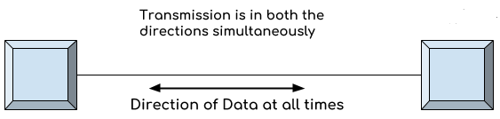
Full-Duplex Mode
1. In full duplex mode both the connected devices can send and receive data simultaneously. The mobile phone we use is an example of full duplex mode where we can communicate simultaneously. 2. Both the devices can send and receive the data at the same time.

Slide 54
Full-Duplex Mode
Advantages of Full Duplex mode: No delays in communication as both can send and receive data simultaneously.
Disadvantages of Full Duplex mode: No proper bandwidth utilization as the same line is used for sending and receiving data at the same time.

Slide 55

Network Topology- Types
https://www.youtube.com/watch?v=e0CWszGpgAE

Slide 56
Network Topology- Types
Topology: physical or logical arrangement of devices
Point-to-point
Mesh
Star
Bus
Ring
Hybrid

Slide 57
Point-to-Point Connection

Slide 58
Fully Connected Mesh Topology
E
A
D
B
C

Slide 59
Fully Connected Mesh Topology

Slide 60
Fully Connected Mesh Topology
Pros:
Dedicated links
Robustness
Privacy
Easy to identify fault
Cons:
A lot of cabling
I/O ports
Difficult to move

Slide 61
Star Topology
A
D
Hub
Drop
B
C
Drop

Slide 62
Star Topology
A
D
Switch
B
C

Slide 63
Star Topology
A
D
Hub
B
C

Slide 64
Star Topology
Pros:
One I/O port per device
Little cabling
Easy to install
Robustness
Easy to identify fault
Cons:
Single point of failure
More cabling still required
Hub

Slide 65
Bus Topology
Drop line
Tap
Terminator

Slide 66
Bus Topology
A
B
C
D

Slide 67
Bus Topology

Slide 68
Bus Topology
Pros:
Little cabling
Easy to install
Cons:
Difficult to modify
Difficult to isolate fault
Break in the bus cable stops all transmission

Slide 69
Ring Topology
C
D
B
A

Slide 70
Ring Topology

Slide 71
Ring Topology
Pros:
Easy to install
Easy to identify fault
Cons:
Delay in large ring
Break in the ring stops all transmission

Slide 72
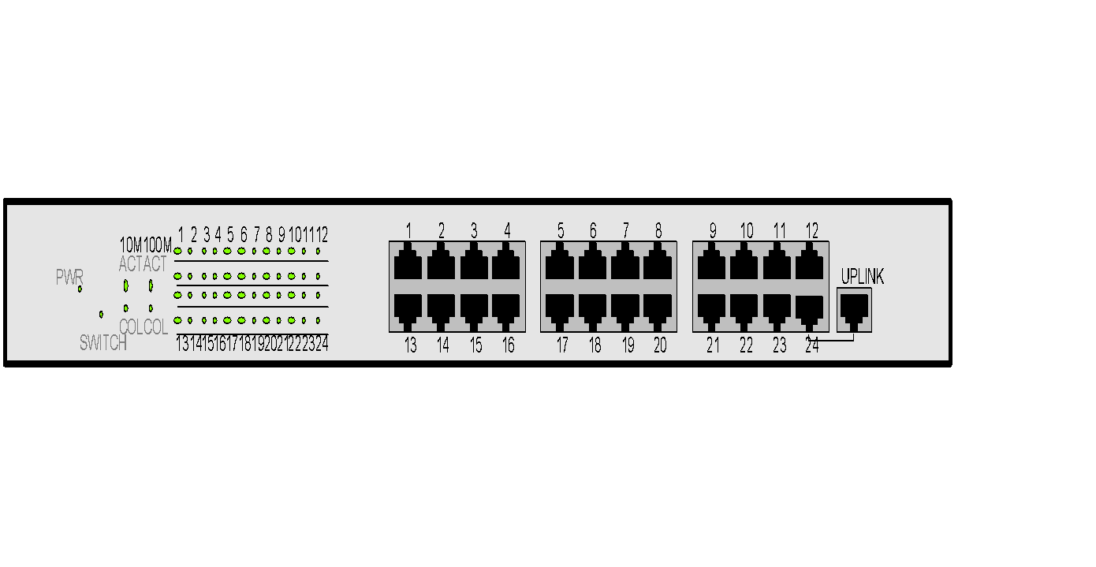
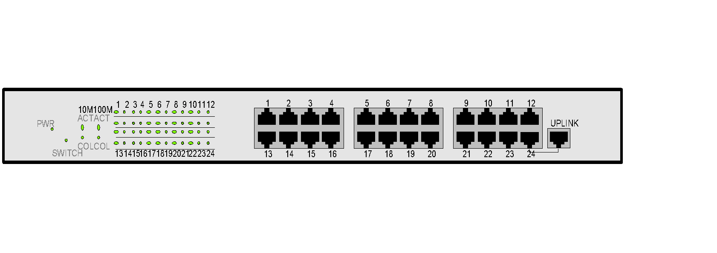
Hybrid Topologies

Slide 73
Network Topology -Comparison
Parameters | Bus | Ring | Star | Mesh
Network Performance | Small | Small or Large | Small | Small
Cable Length Requirement | Less | Neither less nor | More | More
Traffic | Less | High | Medium | No
Dataflow Efficiency | More | Neither less nor more | More | More
Failure | Easy to solve | Difficult to solve | Easy to solve except hub/switch fails | Easy to solve
Cost | Low | High | High | High

Slide 74
Switching
Notes:
‹#›

Slide 75
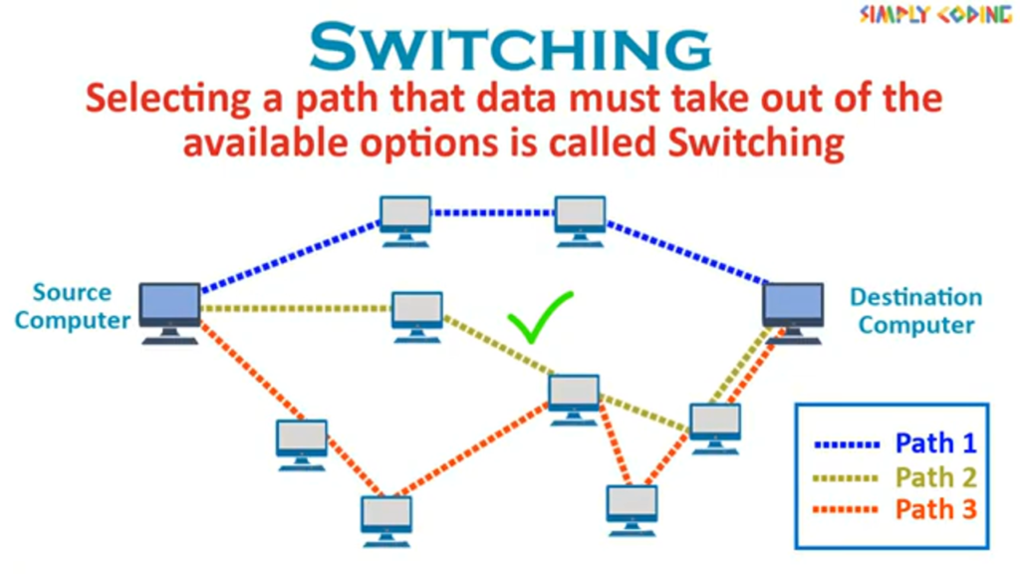

Slide 76
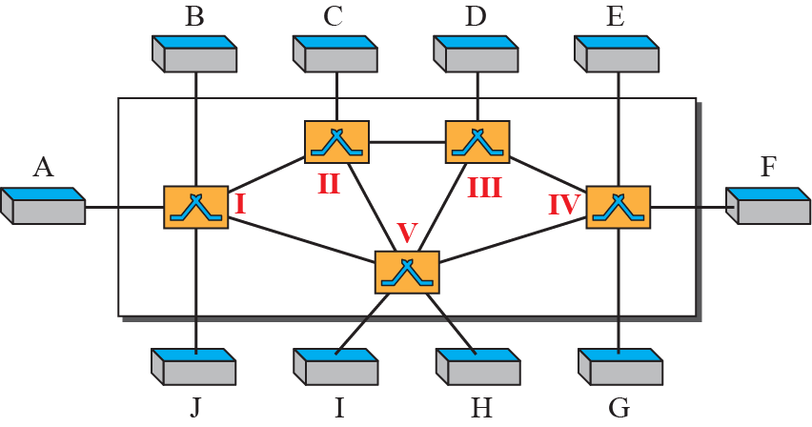
Figure 1: Switched network
Notes:
8.#

Slide 77
Methods of Switching
These are the two most common methods of switching:
circuit switching
packet switching
Packet switching can further be divided into two subcategories,
virtual-circuit approach and
datagram approach
Notes:
8.#

Slide 78
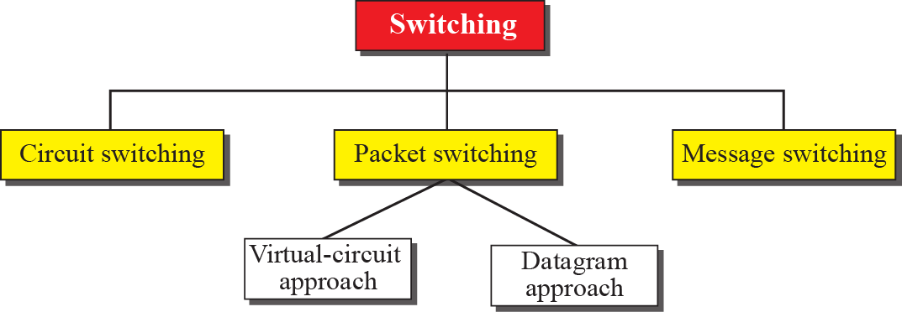
Figure 2: Taxonomy of switched networks
Notes:
8.#

Slide 79
2 CIRCUIT-SWITCHED NETWORKS
A circuit-switched network consists of a set of switches connected by physical links.
Circuit-switches operate at the physical layer.
A circuit-switched network creates a dedicated path to complete a link between the sender and receiver.
Notes:
8.#

Slide 80
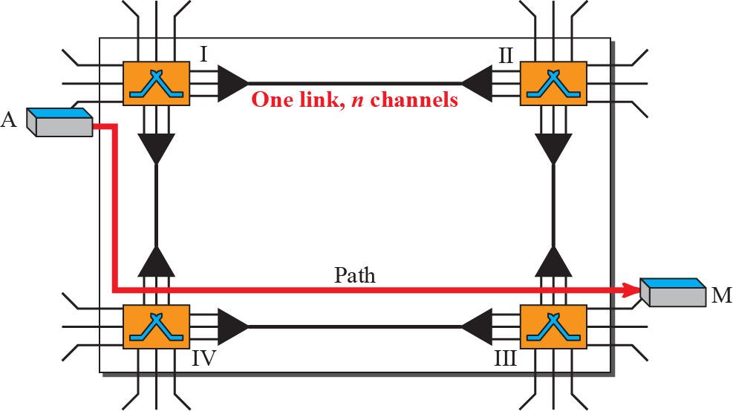
Figure 3: A trivial circuit-switched network
Notes:
8.#

Slide 81
Example 1
As a trivial example, let us use a circuit-switched network to connect eight telephones in a small area. Communication is through 4-kHz voice channels. We assume that each link uses FDM to connect a maximum of two voice channels. The bandwidth of each link is then 8 kHz. Figure 4 shows the situation. Telephone 1 is connected to telephone 7; 2 to 5; 3 to 8; and 4 to 6. Of course the situation may change when new connections are made. The switch controls the connections.

Slide 82
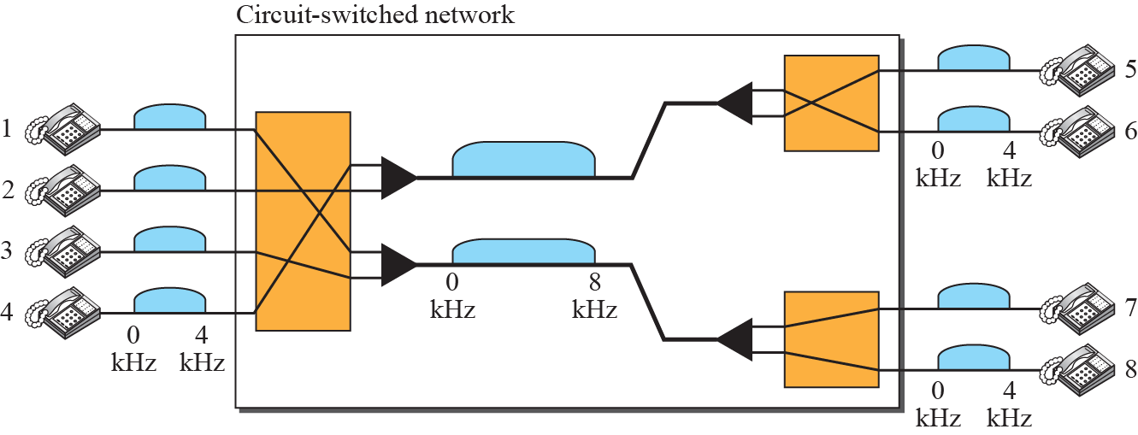
Figure 4: Circuit-switched network used in Example 1
Notes:
8.#

Slide 83
Example 2
As another example, consider a circuit-switched network that connects computers in two remote offices of a private company. The offices are connected using a T-1 line leased from a communication service provider. There are two 4 × 8 (4 inputs and 8 outputs) switches in this network. For each switch, four output ports are folded into the input ports to allow communication between computers in the same office. Four other output ports allow communication between the two offices. Figure 5 shows the situation.

Slide 84
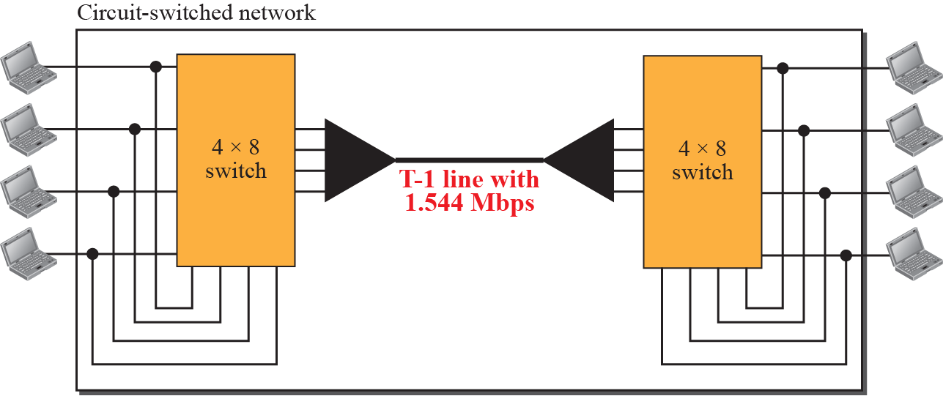
Figure 5: Circuit-switched network used in Example 2
Notes:
8.#

Slide 85
Three Phases
The actual communication in a circuit-switched network requires three phases:
connection setup,
data transfer, and
connection teardown.
Notes:
8.#

Slide 86
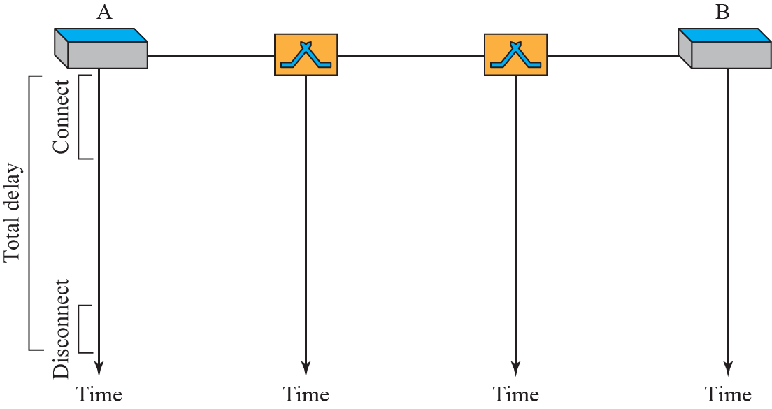
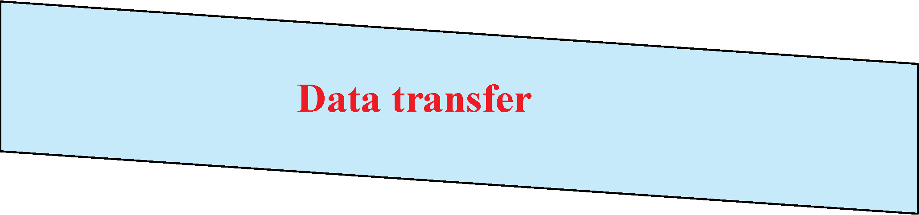
Figure 6 : circuit-switched network three phases
Notes:
8.#

Slide 87
Efficiency
It can be argued that circuit-switched networks are not as efficient as the other two types of networks because resources are allocated during the entire duration of the connection.
These resources are unavailable to other connections. In a telephone network, people normally terminate the communication when they have finished their conversation.
Notes:
8.#

Slide 88
Delay
During data transfer the data are not delayed at each switch; the resources are allocated for the duration of the connection.
Notes:
8.#

Slide 89
Figure 7: Delay in a circuit-switched network
Notes:
8.#

Slide 90
3 PACKET SWITCHING
A packet-switched network divides the data into packets of fixed or variable size.
The size of the packet is determined by the network and the governing protocol.
Packet switched networks are classified as
a) Datagram Networks
b) Virtual circuit Networks
Notes:
8.#

Slide 91
Datagram Networks
In a datagram network, each packet is treated independently of all others.
In a datagram network, each packet is treated independently of all others.
A datagram network operates at the Network layer.
Even if a packet is part of a multipacket transmission, the network treats packets as though they existed alone.
Notes:
8.#

Slide 92
Datagram Networks
Even if a packet is part of a multipacket transmission, the network treats each packet as an independent message.
Each packet of one message can travel a different route towards their final destination.
Packets using this approach are referred to as datagrams.
Notes:
8.#

Slide 93
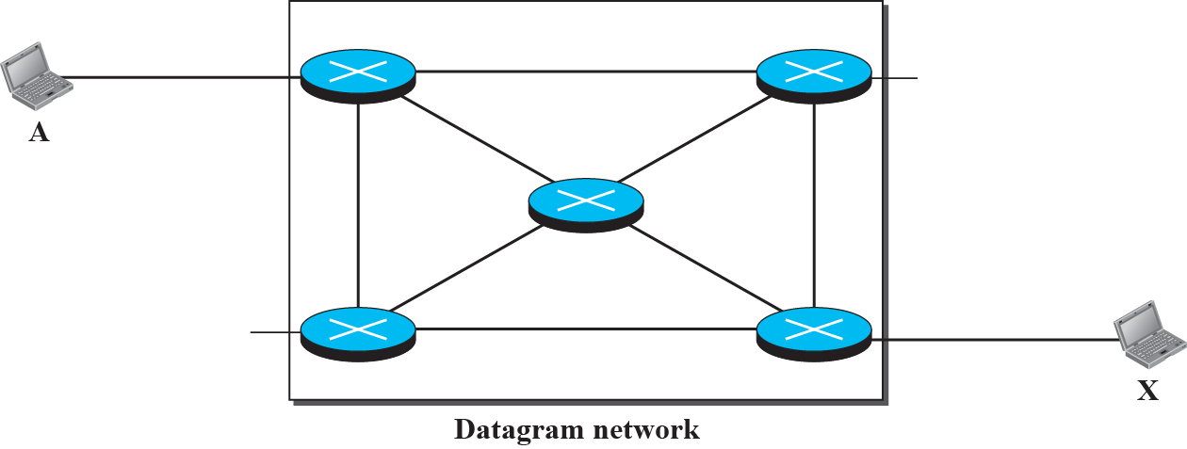
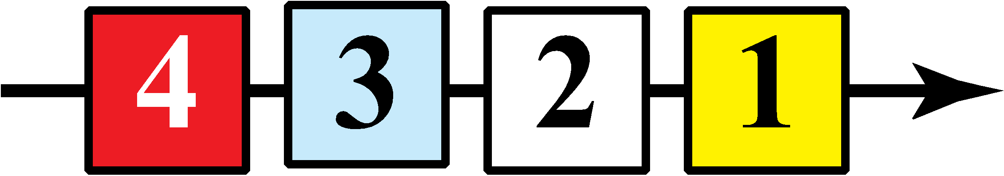






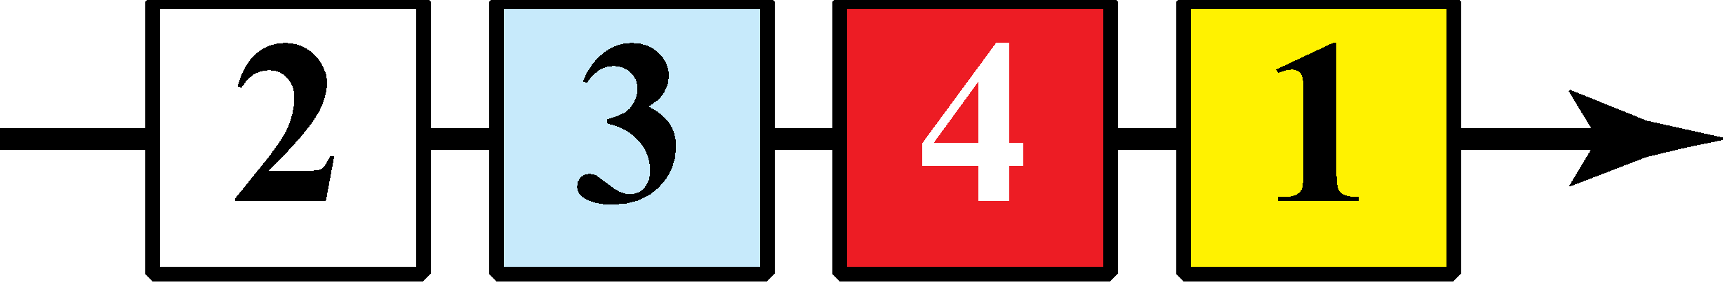

Figure 8: A Datagram network with four 3-level switches
Notes:
8.#

Slide 94
Datagram Networks
All packets have a destination address in the header.
The packets have a destination address in the header.
The destination address for each datagram is used at a router to forward the message towards its final destination.
The packet header contains a sequence number in the header so it can be ordered at the destination.
Notes:
8.#

Slide 95
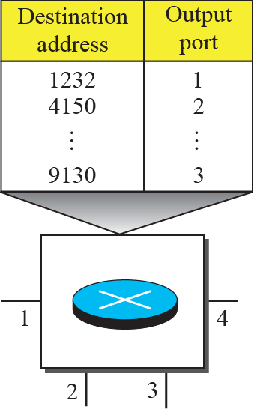
Figure 9: Routing table in a datagram network
Notes:
8.#

Slide 96
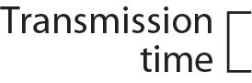
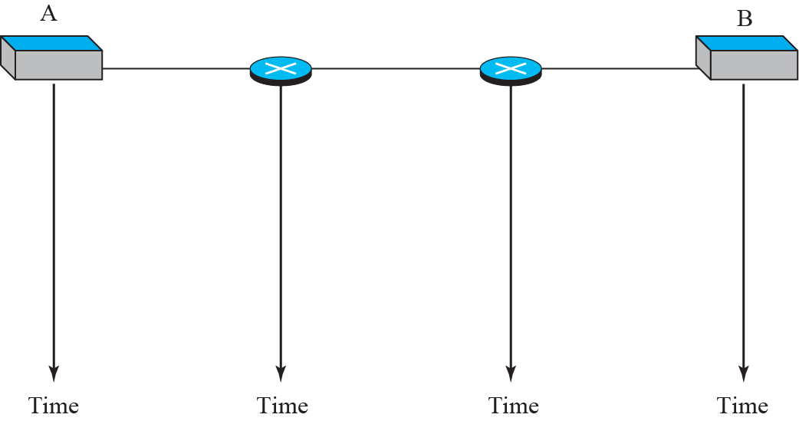

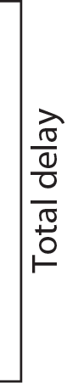
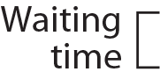

Figure 10: Delays in a datagram network (compare to next slide)
Notes:
8.#

Slide 97
Figure 11: Compare the datagram network to the circuit-switched network
Notes:
8.#

Slide 98
3.1 Virtual-Circuit Networks
A virtual-circuit network is a cross between a circuit-switched network and a datagram network.
The virtual-circuit shares characteristics of both.
The virtual-circuit network operates at the data-link layer.
The packets for a virtual circuit network are known as frames.
Notes:
8.#

Slide 99
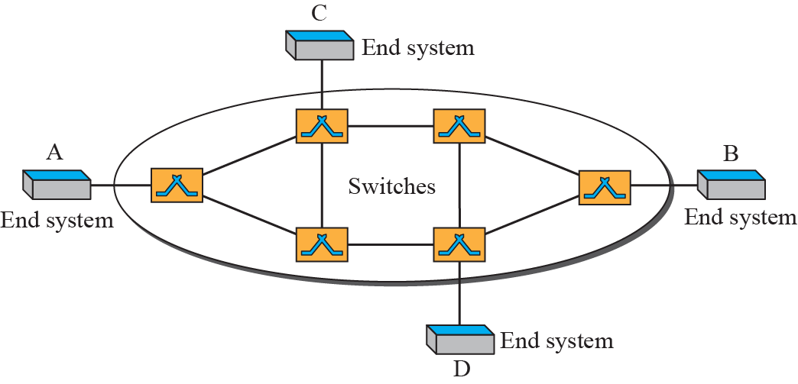
Figure12: Virtual-circuit network
Notes:
8.#

Slide 100
3.2 Virtual-Circuit Networks
A virtual-circuit network uses a series of special temporary addresses known as virtual circuit identifiers (VCI).
The VCI at each switch, is used to advance the frame towards its final destination.
Notes:
8.#

Slide 101
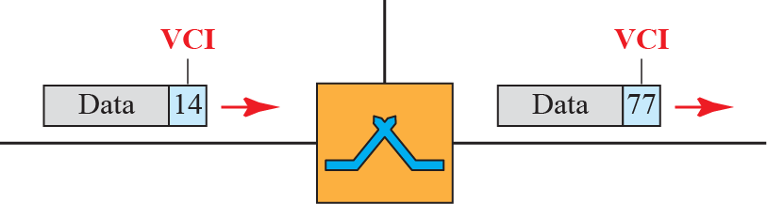
Figure 13: Virtual-circuit identifier (compare the VCI to a Datagram destination address)
Notes:
8.#

Slide 102
3.2 Virtual-Circuit Networks
The switch has a table with 4 columns:
a) Inputs half
Input Port Number
Input VCI
b) Outputs half
Output Port Number
Output VCI
Notes:
8.#

Slide 103
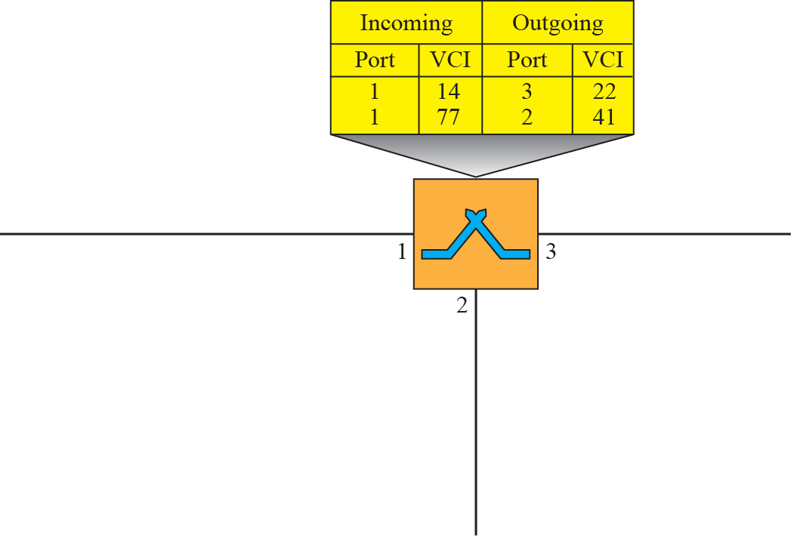



Figure14: Switch and table for a virtual-circuit network
Notes:
8.#

Slide 104
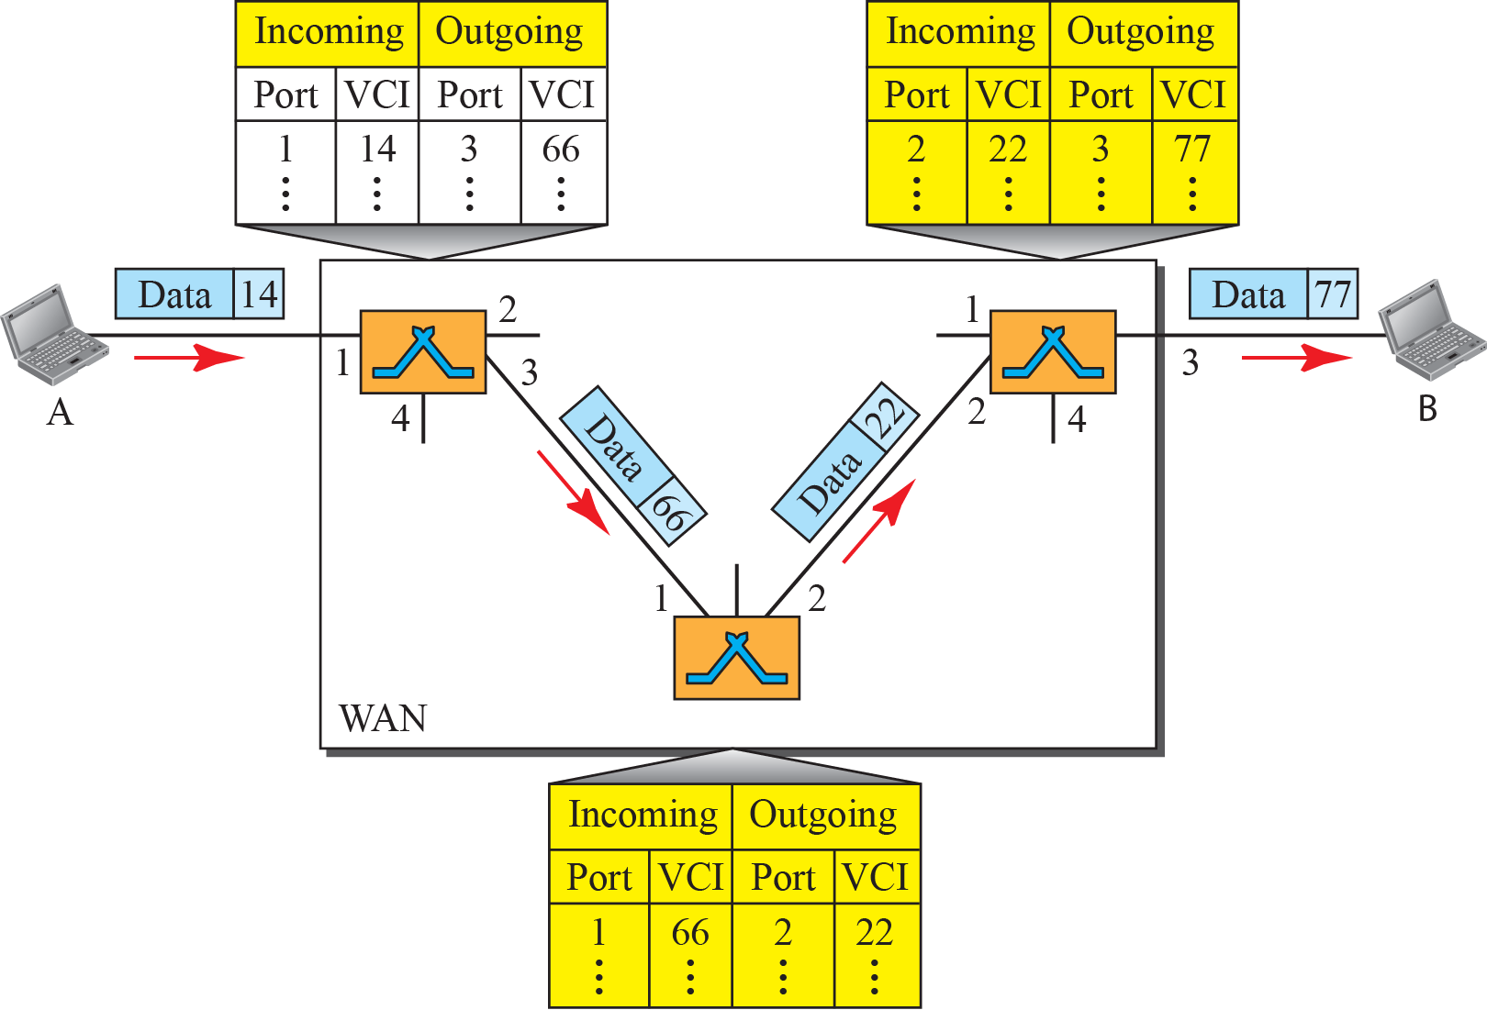
Figure15: Source-to-destination data transfer in a circuit-switch network
Notes:
8.#

Slide 105
Virtual Circuit Networks
The VCN behaves like a circuit switched net because there is a setup phase to establish the VCI entries in the switch table.
There is also a data transfer phase and teardown phase.
.
Notes:
8.#

Slide 106
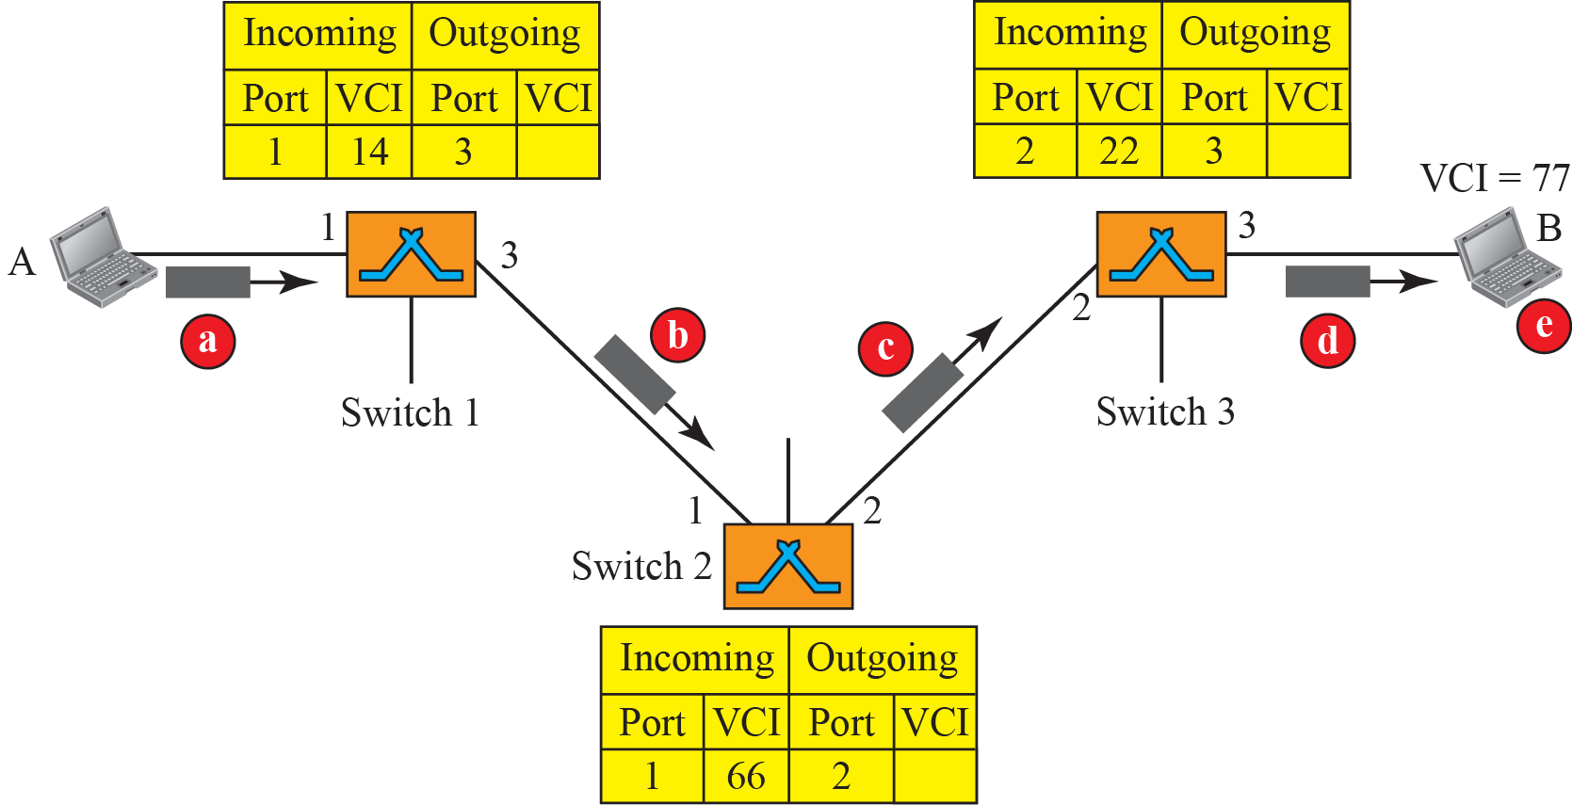
Figure16: Setup request in a virtual-circuit network
All nodes have a VCI
Notes:
8.#

Slide 107
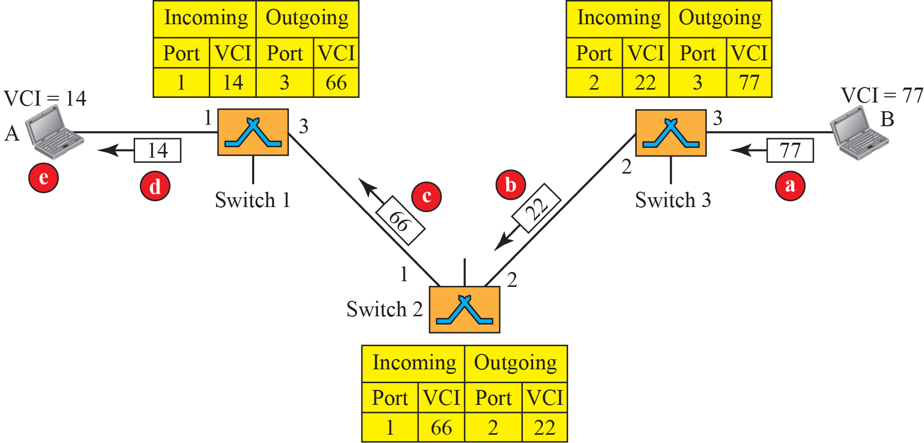
Figure17: Setup acknowledgment in a virtual-circuit network
Notes:
8.#

Slide 108
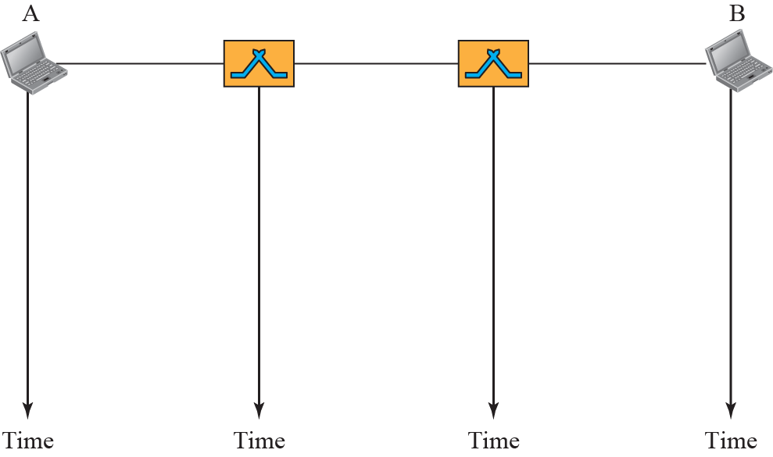


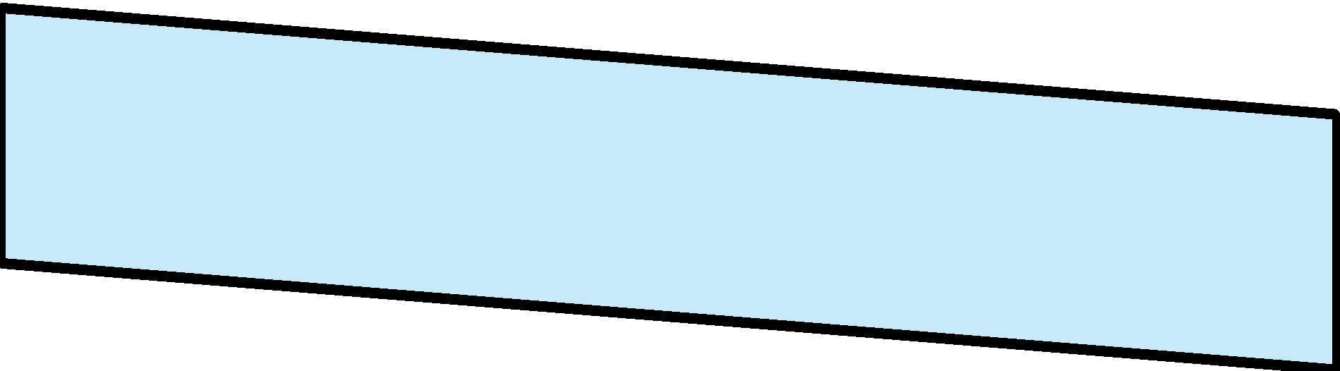

Figure 18: Delay in a virtual-circuit network
Notes:
8.#

Slide 109
Comparison Chart
BASIS | CIRCUIT SWITCHING | PACKET SWITCHING
Orientation | Connection oriented. | Connectionless.
Purpose | Initially designed for Voice communication. | Initially designed for Data Transmission.
Flexibility | Inflexible, because once a path is set all parts of a transmission follows the same path. | Flexible, because a route is created for each packet to travel to the destination.
Order | Message is received in the order, sent from the source. | Packets of a message are received out of order and assembled at the destination.
Technology/Approach | Circuit switching can be achieved using two technologies, either Space Division Switching or Time-Division Switching. | Packet Switching has two approaches Datagram Approach and Virtual Circuit Approach.
Layers | Circuit Switching is implemented at Physical Layer. | Packet Switching is implemented at Network Layer.

Slide 110
Protocols & Standards
Protocols
Communicating worldwide will not be possible if there were no fixed 'standards' that will govern the way user communicates for data as well as the way our devices treat those data
For proper communication, entities in different systems must speak the same language
- there must be mutually acceptable conventions and rules about the content, timing and underlying mechanisms
Those conventions and associated rules are referred as “PROTOCOLS”

Slide 111
Protocols
Network Protocols:
“Network protocols are sets of established rules that dictate how to format, transmit and receive data.
To be able to communicate, two parties (be they software, devices, people, etc.) need:
syntax (data format and coding)
semantics (control information and error handling)
timing (speed matching and sequencing)

Slide 112
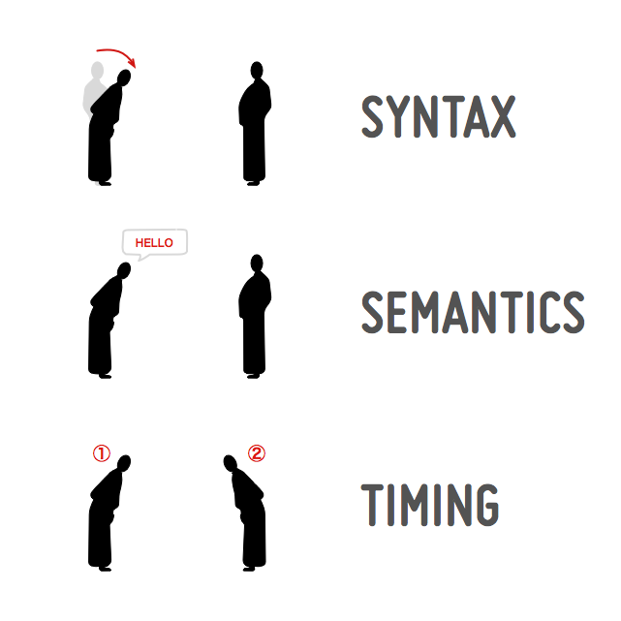

Slide 113
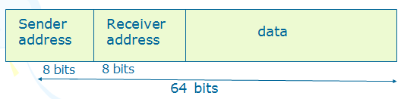
Elements of Protocols
Syntex
Sementics
Timing
1. Syntex
The structure or format of the data. The syntax will be the sequence of characters such as keywords we use for writing the protocols.
Eg. A simple protocol;
ii) Semantics: - The semantics is the meaning associated with each of these keywords. Refers to the meaning of each section of bits.

Slide 114
Elements of Protocols
iii) Timing: the timing is the order in which two or more entities exchange these keywords.
Refers to two characteristics:
When data to be sent
How fast it can be sent
Eg. If a sender produces data at 100 Mbps but the receiver can process data at only 1 Mbps, the transmission will overload the receiver and data will be largely lost.

Slide 115
Characteristics of protocol
(a) Direct / indirect
i) point to point
ii) Multipoint
b) Monolithic / Structured C) Symmetric /Asymmetric
d) Standard / Non standard

Slide 116
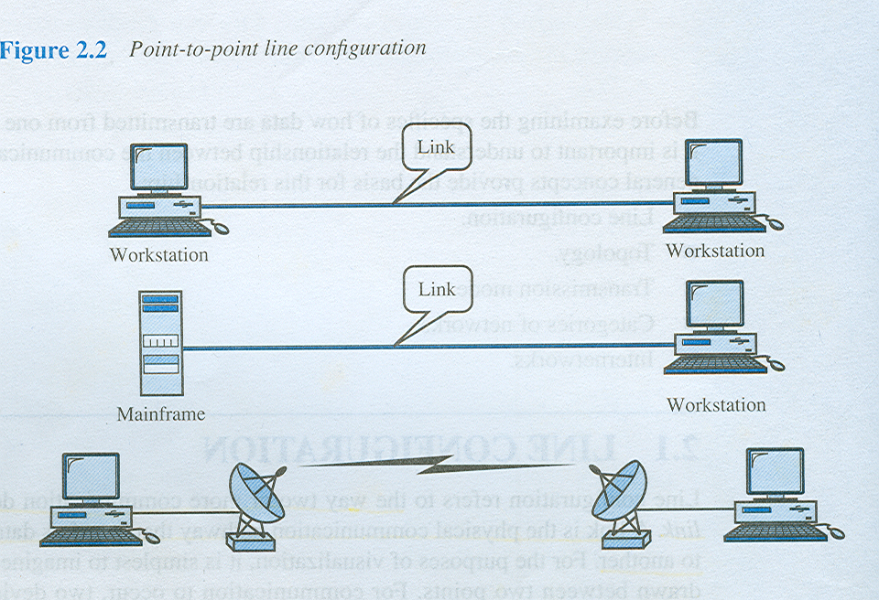
Characteristics of protocol
a) Direct / indirect
Communication between two entities maybe direct or indirect.
i) point-to-point link
- connection provides a dedicated link between two devices
- the entities in these systems may communicate directly that is data and control information pass directly between entities with no intervening active agent.

Slide 117
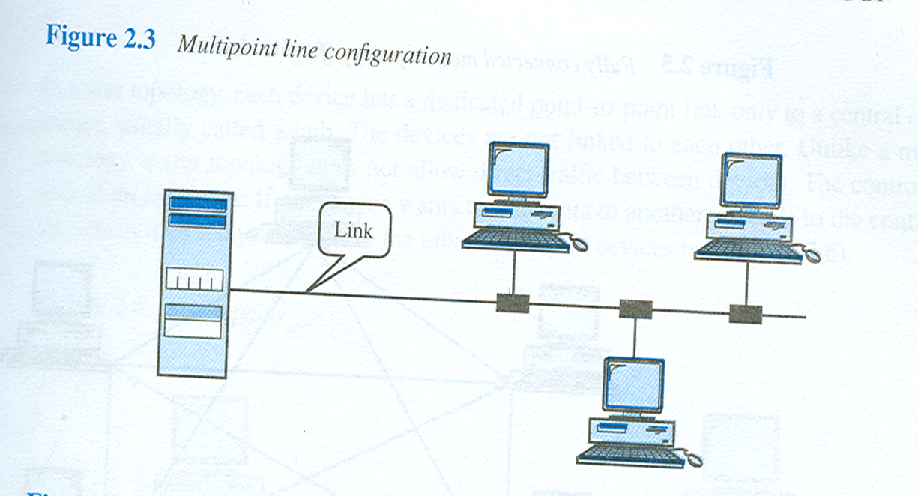
Characteristics of protocol
ii) multipoint link
- connection more than two devices can share a single link
- The entities must be concerned with the issue of access control and making the protocol more complex.

Slide 118
Characteristics of protocol
b) Monolithic / structured
- The task of communication between entities on different systems is too complex to be handled as a unit.
Eg. An electronic mail package running on two computers connected by a synchronous HDLC link. To be structured, the package would need to include all of the HDLC logic. If the connection were over a packet-switched network, the packaged would still need the HDLC logic to attach it to the network.

Slide 119
Characteristics of protocol
c) Symmetric / asymmetric
- Symmetric is the most use in protocol and involve communication between peer entities.
- Asymmetry may be dictated by the logic of an exchange (eg; client and a server process) the desire to keep one of the entities or systems as simple as possible.

Slide 120
Characteristics of protocol
d) Standard / nonstandard
If K different kinds of information sources have to communicate with L types of information receivers, as many as K x L different protocols are needed without standards and a total of 2 x K x L implementations are required
If all systems shared a common protocol, only K+L implementations would be needed.

Slide 121
Standards
Standards are essential in creating and maintaining an open and competitive market for equipment manufacturers and also in guaranteeing national and international interoperability of data and telecommunications technology and processes.
They provide guidelines to manufacturers, vendors, government agencies, and other service providers to ensure the kind of interconnectivity necessary in today's marketplace and in international communication.

Slide 122
Standards
Data communication standards fall into two categories:
de facto ( meaning "by fact" or "by convention") and
de jure (meaning "by law" and "by regulation").
De facto. Standards that have not been approved by an organized body but have been adopted as standards through widespread use are de facto standards.
De jure. De jure standards are those that have been established by an officially recognized body.

Slide 123
Standards and Organizations
Standards are developed through cooperation of standards creation committees, forums and government regulatory agencies.
Some of the standards establishment Organizations are:
International Standards Organization (ISO) http://www.iso.org/
International Telecommunications Union-Telecommunication Standards Sector (ITU-T). http://www.itu.int/ITU-T
American National Standard Institute (ANSI).
Institute of Electrical and Electronics Engineers (IEEE). http://www.ieee.gov/
Electronic Industries Association (EIA).

Slide 124
Regulatory Agencies
All communications technology is subject to regulation by government agencies such as Federal Communication Commission (FCC) in the United States.
The purpose of these agencies is to protect the public interest by regulating radio, television, and wire/cable communications. Federal Communications Commission (FCC)
http://www.fcc.gov/
The Federal Communications Commission (FCC) has authority over interstate and international commerce as it relates to communications

Slide 125
Standard Protocol Architectures
Two approaches (standard)
OSI Reference model
never used widely
but well known
TCP/IP protocol suite
Most widely used

Slide 126
OSI Reference Model
Open Systems Interconnection (OSI)
Reference model
provides a general framework for standardization
defines a set of layers and services provided by each layer
one or more protocols can be developed for each layer
Developed by the International Organization for Standardization (ISO)

Slide 127
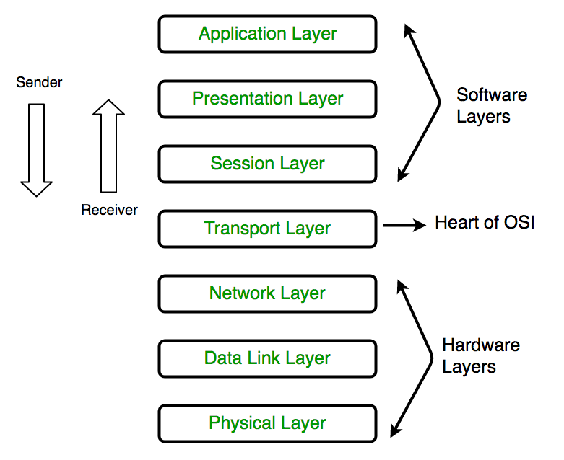

Slide 128
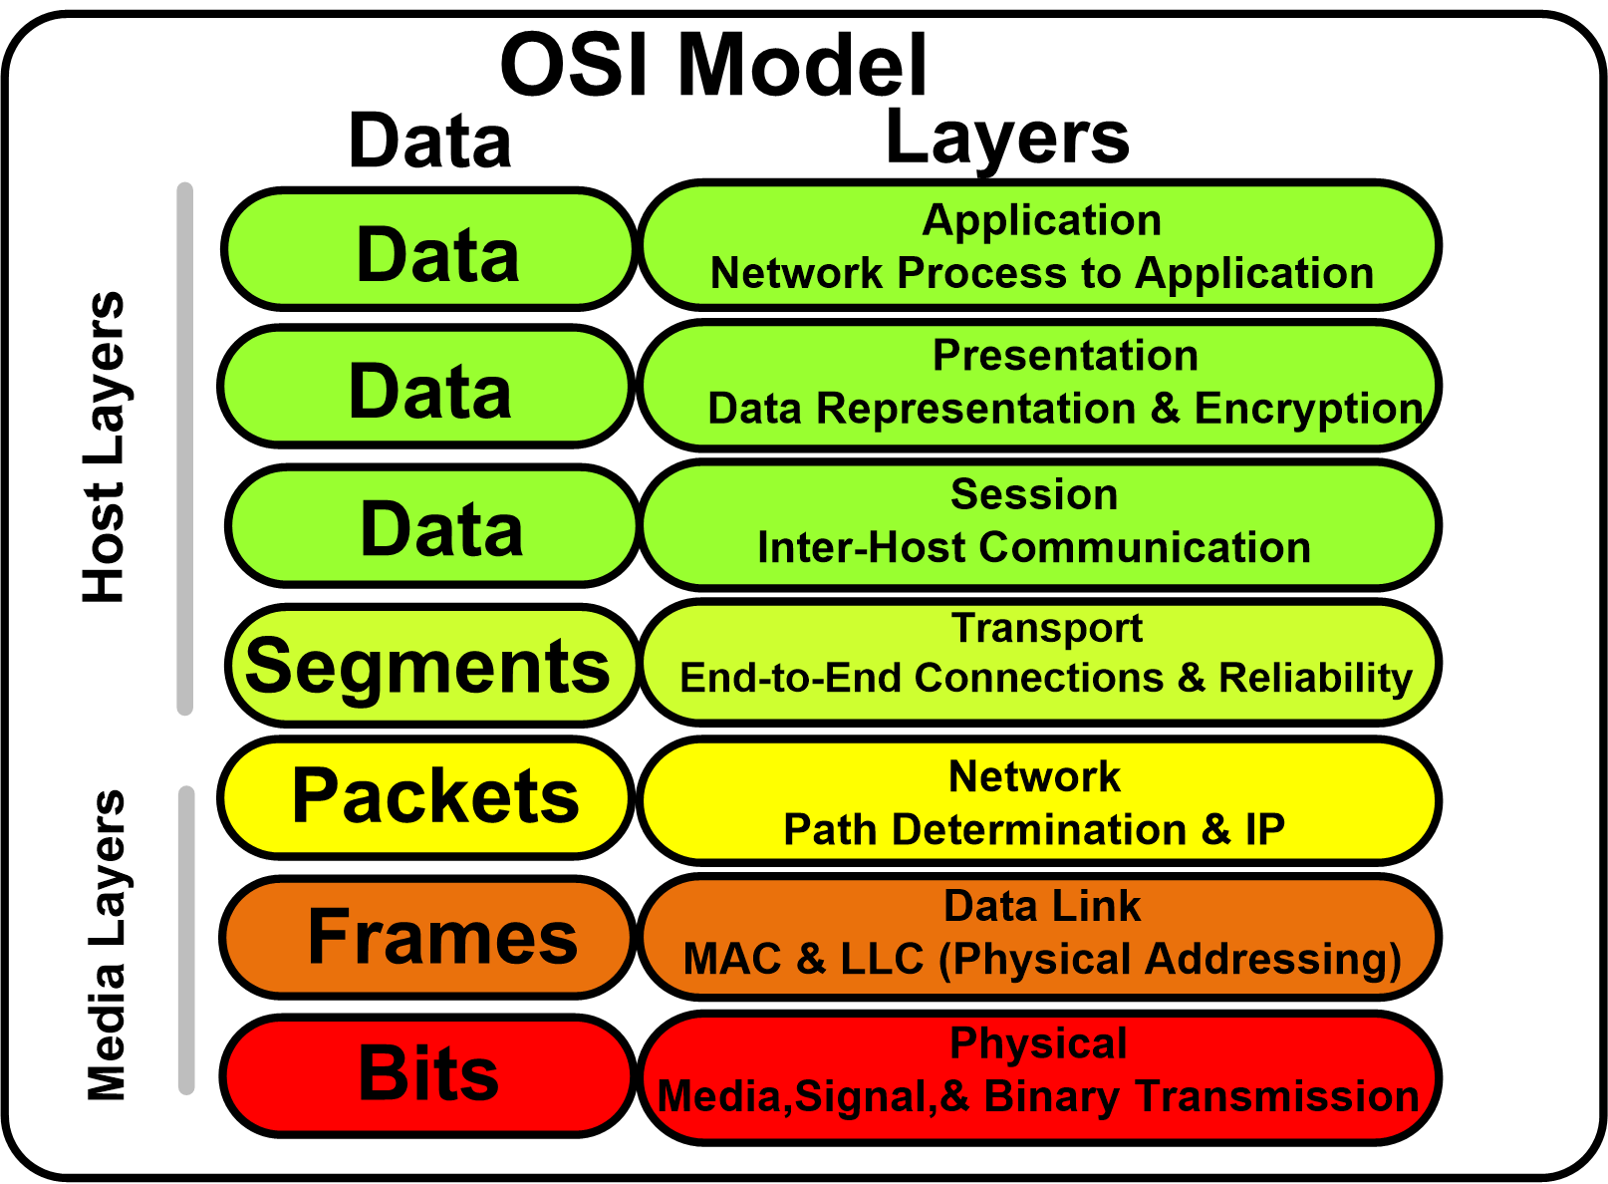

Slide 129
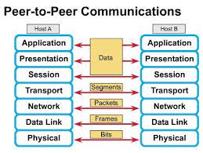

Slide 130

OSI as Framework for Standardization
layer functionalities are described by ISO; different standards can be developed based on these functionalities

Slide 131


Slide 132

The OSI Architecture

Slide 133


Layer to Layer Communication

Slide 134
Benefits of the OSI Model
Benefits of the OSI model include:
Divides the aspects of network operations into less complex components.
Standardizes interfaces, enabling engineers to specialize design and development efforts to specific functions.
Facilitates modular engineering and prevents changes in one area from affecting others.
Accelerates evolution and helps with testing and troubleshooting the network.

Slide 135
Mnemonic
Please Do Not Throw Sausage Pizza Away
Please → Physical
Do → Data Link
Not → Network
Throw → Transport
Sausage → Session
Pizza → Presentation
Away → Application

Slide 136

Physical Layer
The main functionality of the physical layer is to transmit the individual bits from one node to another node.
It is the lowest layer of the OSI model.
It establishes, maintains and deactivates the physical connection.
It specifies the mechanical, electrical and procedural network interface specifications.

Slide 137
Physical Layer
Functions of a Physical layer:
Line Configuration:
It defines the way how two or more devices can be connected physically.
Data Transmission:
It defines the transmission mode whether it is simplex, half-duplex or full-duplex mode between the two devices on the network.
Topology:
It defines the way how network devices are arranged.
Signals:
It determines the type of the signal used for transmitting the information.

Slide 138

Datalink Layer

Slide 139
Datalink Layer
This layer is responsible for the error-free transfer of data frames.
It defines the format of the data on the network.
It provides a reliable and efficient communication between two or more devices.
It is mainly responsible for the unique identification of each device that resides on a local network.
It handles timing:
It must know where one bit ends and the next one begins.
It must know where one byte ends and the next one begins
It contains two sub-layers:
Logical Link Control (LLC) Layer
It is responsible for transferring the packets to the Network layer of the receiver that is receiving.
It identifies the address of the network layer protocol from the header.
It also provides flow control.
Media Access Control (MAC) Layer
A Media access control layer is a link between the Logical Link Control layer and the network's physical layer.
It is used for transferring the packets over the network.

Slide 140

Functions of the Data-link layer
Framing: The data link layer translates the physical's raw bit stream into packets known as Frames. The Data link layer adds the header and trailer to the frame. The header which is added to the frame contains the hardware destination and source address.
Physical Addressing: The Data link layer adds a header to the frame that contains a destination address. The frame is transmitted to the destination address mentioned in the header.
Flow Control: Flow control is the main functionality of the Data-link layer. It is the technique through which the constant data rate is maintained on both the sides so that no data get corrupted. It ensures that the transmitting station such as a server with higher processing speed does not exceed the receiving station, with lower processing speed.
Error Control: Error control is achieved by adding a calculated value CRC (Cyclic Redundancy Check) that is placed to the Data link layer's trailer which is added to the message frame before it is sent to the physical layer. If any error seems to occurr, then the receiver sends the acknowledgment for the retransmission of the corrupted frames.
Access Control: When two or more devices are connected to the same communication channel, then the data link layer protocols are used to determine which device has control over the link at a given time.

Slide 141

Network Layer

Slide 142
Network Layer
It is a layer 3 that manages device addressing, tracks the location of devices on the network.
It determines the best path to move data from source to the destination based on the network conditions, the priority of service, and other factors.
The Data link layer is responsible for routing and forwarding the packets.
Routers are the layer 3 devices, they are specified in this layer and used to provide the routing services within an internetwork.
The protocols used to route the network traffic are known as Network layer protocols. Examples of protocols are IP and Ipv6.

Slide 143
Network Layer
The router acted at this layer.
One of the main functions of the layer is routing. Store and forward are network layer functions.
In a connection-oriented scheme, the virtual circuit is established at the network layer.
Building the routing tables, troubleshooting the routing tables when there is a lot of traffic or if a connection goes down.
The network layer also gathers related packets (packet sequencing).

Slide 144
Functions of Network Layer:
Internetworking: An internetworking is the main responsibility of the network layer. It provides a logical connection between different devices.
Addressing: A Network layer adds the source and destination address to the header of the frame. Addressing is used to identify the device on the internet.
Routing: Routing is the major component of the network layer, and it determines the best optimal path out of the multiple paths from source to the destination.
Packetizing: A Network Layer receives the packets from the upper layer and converts them into packets. This process is known as Packetizing. It is achieved by internet protocol (IP).

Slide 145
Transport Layer
As stated before, Layer 4 is the dividing line between inter-computer transactions and intra-computer transactions.
Layer 4 manages end-to-end verification.
The lower layers make a “best effort” but if data is lost so be it. Layer 4 must ensure that the information was received intact.
It does a higher-order error-checking.
The transfer should be “transparent.” The higher layers do not know the data came from another computer.
At a node Layer 3 collects associated packets if one was dropped it may throw them all away.
It is the responsibility of the source’s Layer 4 to look for some acknowledgement that all packets arrived. If no acknowledgment is received, it should retransmit

Slide 146

Transport Layer

Slide 147
The two protocols used in this layer are:
Transmission Control Protocol
It is a standard protocol that allows the systems to communicate over the internet.
It establishes and maintains a connection between hosts.
When data is sent over the TCP connection, then the TCP protocol divides the data into smaller units known as segments. Each segment travels over the internet using multiple routes, and they arrive in different orders at the destination. The transmission control protocol reorders the packets in the correct order at the receiving end.
User Datagram Protocol
User Datagram Protocol is a transport layer protocol.
It is an unreliable transport protocol as in this case receiver does not send any acknowledgment when the packet is received, the sender does not wait for any acknowledgment. Therefore, this makes a protocol unreliable.

Slide 148
Functions of Transport Layer:
Service-point addressing: Computers run several programs simultaneously due to this reason, the transmission of data from source to the destination not only from one computer to another computer but also from one process to another process. The transport layer adds the header that contains the address known as a service-point address or port address. The responsibility of the network layer is to transmit the data from one computer to another computer and the responsibility of the transport layer is to transmit the message to the correct process.
Segmentation and reassembly: When the transport layer receives the message from the upper layer, it divides the message into multiple segments, and each segment is assigned with a sequence number that uniquely identifies each segment. When the message has arrived at the destination, then the transport layer reassembles the message based on their sequence numbers.
Connection control: Transport layer provides two services Connection-oriented service and connectionless service. A connectionless service treats each segment as an individual packet, and they all travel in different routes to reach the destination. A connection-oriented service makes a connection with the transport layer at the destination machine before delivering the packets. In connection-oriented service, all the packets travel in the single route.
Flow control: The transport layer also responsible for flow control but it is performed end-to-end rather than across a single link.
Error control: The transport layer is also responsible for Error control. Error control is performed end-to-end rather than across the single link. The sender transport layer ensures that message reach at the destination without any error.

Slide 149

Session Layer

Slide 150
Session Layer
It is an agreement between a source and destination to communicate.
This layer establishes, manages and terminates sessions between applications (they could be on the same computer or on different computers).
Functions of Session layer:
Dialog control: Session layer acts as a dialog controller that creates a dialog between two processes or we can say that it allows the communication between two processes which can be either half-duplex or full-duplex.
Synchronization: Session layer adds some checkpoints when transmitting the data in a sequence. If some error occurs in the middle of the transmission of data, then the transmission will take place again from the checkpoint. This process is known as Synchronization and recovery.

Slide 151

Presentation Layer

Slide 152
Presentation Layer
A Presentation layer is mainly concerned with the syntax and semantics of the information exchanged between the two systems.
It acts as a data translator for a network.
This layer is a part of the operating system that converts the data from one presentation format to another format.
The Presentation layer is also known as the syntax layer.

Slide 153
Functions of Presentation layer:
Translation: The processes in two systems exchange the information in the form of character strings, numbers and so on. Different computers use different encoding methods, the presentation layer handles the interoperability between the different encoding methods. It converts the data from sender-dependent format into a common format and changes the common format into receiver-dependent format at the receiving end.
Encryption: Encryption is needed to maintain privacy. Encryption is a process of converting the sender-transmitted information into another form and sends the resulting message over the network.
Compression: Data compression is a process of compressing the data, i.e., it reduces the number of bits to be transmitted. Data compression is very important in multimedia such as text, audio, video.

Slide 154

Application Layer

Slide 155
An application layer serves as a window for users and application processes to access network service.
It handles issues such as network transparency, resource allocation, etc.
An application layer is not an application, but it performs the application layer functions.
This layer provides the network services to the end-users.

Slide 156
Functions of Application layer:
File transfer, access, and management (FTAM): An application layer allows a user to access the files in a remote computer, to retrieve the files from a computer and to manage the files in a remote computer.
Mail services: An application layer provides the facility for email forwarding and storage.
Directory services: An application provides the distributed database sources and is used to provide that global information about various objects.

Slide 157


Slide 158
Hypertext Transfer Protocol –HTTP
File Transfer Protocol - FTP
Simple Network Management Protocol - SNMP
Domain Name System - DNS Teletype Network Protocol - TELNET
Simple Mail Transfer Protocol – SMTP
Dynamic Host Configuration Protocol - DHCP
secure sockets layer -_SSL
Transport Layer Security – TLS
Point-to-Point Tunneling Protocol - PPTP
Session Initiation Protocol - SIP
Session Announcement Protocol - SAP
Network Basic Input/Output System- NETBIOS
Transmission Control Protocol - TCP
User Datagram Protocol - UDP
Internet Control Message Protocol - ICMP
interior gateway protocol - IGP
Exterior Gateway Protocol - EGP
Asynchronous Transfer Mode - ATM
Serial Line Internet Protocol - SLIP
Universal Serial Bus (USB) - USB
Point to point Protocol - PPP

Slide 159
Session 6
TCP/IP Protocol suite
Comparison between OSI and TCP
Introduction to link layer protocols.- Noiseless Channel and Noisy Channel
Addressing

Slide 160


Slide 161

TCP/IP Protocol Suite
Four layer Network Interface

Slide 162
TCP/IP Protocol Suite
The Layers used in the TCP/IP protocol
Application layer
Transport (host to host / end to end) layer
Internet layer
Network Interface
Network access layer
Physical layer

Slide 163

Application Layer

Slide 164

Application Layer

Slide 165

Transport Layer

Slide 166


Slide 167


Slide 168


Slide 169
Internet Layer
Connectionless, point to point internetworking protocol (uses the datagram approach)
takes care of routing across multiple networks
each packet travels in the network independently of each other
they may not arrive (if there is a problem in the network)
they may arrive out of order
a design decision enforced by DoD to make the system more flexible and responsive to loss of some subnet devices
Implemented in end systems and routers as the Internet Protocol (IP)

Slide 170

Network Access and Physical Layers

Slide 171
https://www.youtube.com/watch?v=oDFDS49JADM
https://www.youtube.com/watch?v=9ndoxFjYqPs

Slide 172

OSI vs. TCP/IP
HTTP, SMTP, …
TCP, UDP
IP

Slide 173



OSI vs. TCP/IP

Slide 174


OSI vs. TCP/IP

Slide 175
Introduction to link layer protocols
Traditionally four protocols have been defined for the data-link layer to deal with flow and error control:
Simple,
Stop-and-Wait,
Go-Back-N, and (Will be discussed in Unit 4)
Selective-Repeat (Will be discussed in Unit 4)

Slide 176
Simple Protocol
The simple protocol neither do flow control nor do error control.
We assume that the receiver can immediately handle any frame it receives.
In other words, the receiver can never be overwhelmed with incoming frames.
Below figure shows the layout for this protocol.

Slide 177

Simple Protocol
The DLL at the sender gets a packet from its network layer, makes a frame out of it, and sends the frame.
The DLL at the receiver receives a frame from the link, extracts the packet from the frame, and delivers the packet to its network layer.
The DLLs of the sender and receiver provide transmission services for their network layers

Slide 178
Stop-and-Wait Protocol
The Stop-and- Wait protocol uses both flow and error control.
The sender sends one frame at a time and waits for an acknowledgment before sending the next one.
To detect corrupted frames, we need to add a CRC to each data frame.
When a frame arrives at the receiver site, it is checked. If its CRC is incorrect, the frame is corrupted and silently discarded.

Slide 179

Stop-and-Wait Protocol

Slide 180
Other DLL Protocols
HDLC
Point-to-Point Protocol (P2P)
Multiple Access Protocols
Note: They will be discussed in unit 4

Slide 181
Noiseless & Noise Channels
Noiseless Channel
An ideal channel in which no frames are lost, duplicated or corrupted is regarded as Noiseless Channel.
Protocols belong to this channel are
Simple & Stop-and-wait protocols
Noisy Channels
Consider the normal situation of a communication channel that makes errors. Frames may be either damaged or lost completely.
Protocols belong to this channel are
ARQ (Automatic Repeat Request Protocols)

Slide 182
ADDRESSING
Four levels of addresses are used in an internet employing the TCP/IP protocols:
physical address,
logical address,
port address, and
application-specific address.
Each address is related to a one layer in the TCP/IP architecture, as shown in the following Figure.

Slide 183

ADDRESSING

Slide 184

ADDRESSING
Physical Addresses
The physical address, also known as the link address, is the address of a node as defined by its LAN or WAN.
It is included in the frame used by the data link layer. It is the lowest-level address.
The size and format of these addresses vary depending on the network.
For example, Ethernet uses a 6-byte (48-bit) physical address that is imprinted on the network interface card (NIC).
Most local area networks use a 48-bit (6-byte) physical address written as 12 hexadecimal digits; every byte (2 hexadecimal digits) is separated by a colon, as shown below.

Slide 185
ADDRESSING
Unicast, Multicast, and Broadcast Physical Addresses
Physical addresses can be either
Unicast (one single recipient),
multicast (a group of recipients), or
broadcast (to be received by all systems in the network).
Some networks support all three addresses

Slide 186
ADDRESSING
Logical Addresses
Logical addresses are necessary for universal communications that are independent of underlying physical networks.
Physical addresses are not adequate in an internetwork environment where different networks can have different address formats.
A universal addressing system is needed in which each host can be identified uniquely, regardless of the underlying physical network.
The logical addresses are designed for this purpose

Slide 187
ADDRESSING
Port Addresses
The end objective of Internet communication is a process communicating with another process.
For example, computer A can communicate with computer C by using TELNET. At the same time, computer A communicates with computer B by using the File Transfer Protocol (FTP).
For these processes to receive data simultaneously, we need a method to label the different processes.
In other words, they need addresses. In the TCP/IP architecture, the label assigned to a process is called a port address.
A port address in TCP/IP is 16 bits in length.

Slide 188
ADDRESSING
Application-Specific Addresses
Some applications have user-friendly addresses that are designed for that specific application.
Examples include the e-mail address (for example, co_sci@yahoo.com) and the Universal Resource Locator (URL) (for example, www.mhhe.com).
The first defines the recipient of an e-mail; the second is used to find a document on the World Wide Web.
These addresses, however, get changed to the corresponding port and logical addresses by the sending computer.

Slide 189
Session 9
Network layer protocols:
ARP - is used in address mapping
RARP - used in address mapping but in reverse
ICMP - handle some errors that may occur in delivery.

Slide 190

Position of NLP in TCP/IP Stack Suite

Slide 191
ICMP V4
ICMPv4 - The IPv4 has no error-reporting or error-correcting mechanism
The IP protocol also lacks a mechanism for host and management queries
The Internet Control Message Protocol version 4 (ICMPv4) has been designed to compensate for the above two deficiencies
ICMP MESSAGES
Error-reporting messages report problems that a router or a host (destination) may encounter when it processes an IP packet.
Query messages help a host or a network manager get specific information from a router or another host.

Slide 192


ICMP V4
General format of ICMP messages

Slide 193

ICMP V4
Contents of data field for the error messages

Slide 194

ARP
Address Resolution Protocol

Slide 195

ARP
Reaching a Physical Host

Slide 196

ARP
Manual Mapping

Slide 197

ARP

Slide 198

ARP Idea

Slide 199

ARP Cache

Slide 200

ARP in Ethernet Frame

Slide 201

ARP Message Format

Slide 202

Simple ARP Request/Reply

Slide 203

ARP Cache Updating

Slide 204

Proxy ARP

Slide 205

Reverse Address Resolution Protocol (RARP)

Slide 206

RARP Packet Format

Slide 207

RARP Request/Reply

Slide 208

RARP Problems

Slide 209

RARP Problems

Slide 210
Session 10
Transport layer Protocols
- TCP and UDP
Data transmission
Parallel and Serial
Serial transmission types

Slide 211
TCP
Transmission Control Protocol
end to end protocol
Reliable connection = provides flow and error control
In TCP terms, a connection is a
temporary association between entities in different systems
TCP PDU
Called “TCP segment”
Includes source and destination port
Identify respective users (applications)
pair of ports (together with the IP addresses) uniquely identify a connection; such an identification is necessary in order TCP to track segments between entities.

Slide 212

TCP Header

Slide 213
UDP
User Datagram Protocol
Alternative to TCP
end-to-end protocol
Not guaranteed delivery
No preservation of sequence
No protection against duplication
Minimum overhead

Slide 214

PDUs in TCP/IP
Dest. Port
Sequence number
Checksum
….
Dest. Address
Source address
….
Dest. Network Address
Priority info

Slide 215

Operation of TCP and IP

Slide 216



Slide 217
Data Transmission
Data transmission refers to the process of transferring data between two or more digital devices.
Data is transmitted from one device to another in analog or digital format.
Basically, data transmission enables devices or components within devices to speak to each other.
There are two methods used to transmit data between digital devices: serial transmission and parallel transmission

Slide 218
Serial Data Transmission
When data is sent or received using serial data transmission, the data bits are organized in a specific order, since they can only be sent one after another.
The order of the data bits is important as it dictates how the transmission is organized when it is received.
It is viewed as a reliable data transmission method because a data bit is only sent if the previous data bit has already been received.

Slide 219

Serial Data Transmission

Slide 220
Serial Data Transmission
Asynchronous Serial Transmission Data bits can be sent at any point in time. Stop bits and start bits are used between data bytes to synchronize the transmitter and receiver and to ensure that the data is transmitted correctly. The time between sending and receiving data bits is not constant, so gaps are used to provide time between transmissions.

Slide 221
Serial Data Transmission
The advantage of using the asynchronous method is that no synchronization is required between the transmitter and receiver devices. It is also a more cost effective method.
A disadvantage is that data transmission can be slower, but this is not always the case.
Serial transmission is normally used for long-distance data transfer. It is also used in cases where the amount of data being sent is relatively small. It ensures that data integrity is maintained as it transmits the data bits in a specific order, one after another. In this way, data bits are received in-sync with one another

Slide 222
Serial Data Transmission
Synchronous Serial Transmission Data bits are transmitted as a continuous stream in time with a master clock. The data transmitter and receiver both operate using a synchronized clock frequency; therefore, start bits, stop bits, and gaps are not used. This means that data moves faster and timing errors are less frequent because the transmitter and receiver time is synced. However, data accuracy is highly dependent on timing being synced correctly between devices. In comparison with asynchronous serial transmission, this method is usually more expensive.

Slide 223

Parallel Data Transmission
When data is sent using parallel data transmission, multiple data bits are transmitted over multiple channels at the same time.
This means that data can be sent much faster than using serial transmission methods.

Slide 224
Parallel Data Transmission
Given that multiple bits are sent over multiple channels at the same time, the order in which a bit string is received can depend on various conditions, such as proximity to the data source, user location, and bandwidth availability.
Two examples of parallel interfaces can be seen below. In the first parallel interface, the data is sent and received in the correct order.
In the second parallel interface, the data is sent in the correct order, but some bits were received faster than others.

Slide 225

Parallel Data Transmission

Slide 226
Parallel Data Transmission
The main advantages of parallel transmission over serial transmission are:
it is easier to program;
data is sent faster.
Although parallel transmission can transfer data faster, it requires more transmission channels than serial transmission. This means that data bits can be out of sync, depending on transfer distance and how fast each bit loads.
A simple of example of where this can be seen is with a voice over IP (VOIP) call when distortion or interference is noticeable. It can also be seen when there is skipping or interference on a video stream.

Slide 227
Parallel Data Transmission
Parallel transmission is used when:
- a large amount of data is being sent;
- the data being sent is time-sensitive;
- and the data needs to be sent quickly.
A scenario where parallel transmission is used to send data is video streaming. When a video is streamed to a viewer, bits need to be received quickly to prevent a video pausing or buffering.
Video streaming also requires the transmission of large volumes of data.
The data being sent is also time-sensitive as slow data streams result in poor viewer experience.

Slide 228

Serial Vs Parallel

Slide 229
Unit – I End

